Slide 1


Car Rental Service
Presented by:
Vaishnavi Alur

Slide 2


Agenda
Problem Statement
Project Overview
Your solution and it’s value proposition
The wow in your solution
Who are the end users
The real words use cases
Learning outcome

Slide 3
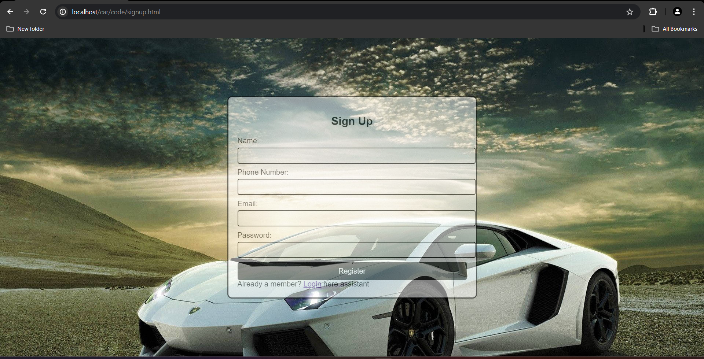
Problem Statement
Managing and keeping all the booking data is a very tedious task and very difficult.
Especially when customer change the pricing or offer any deals.
Customers demand quick, convenient, and reliable solutions for their car rental needs.
Solutions are found through the website to overcome challenges and provide good solutions to customers.

Slide 4
Project Overview
The car rental website project aims to create an intuitive online platform for users to browse, select, and book rental vehicles.
The website will feature a diverse fleet, real-time availability updates, and secure payment options. Users can filter cars by type, price, and location, with detailed descriptions and images.
The platform will include user accounts for booking management and loyalty rewards. Comprehensive customer support and feedback mechanisms will ensure a seamless rental experience.

Slide 5
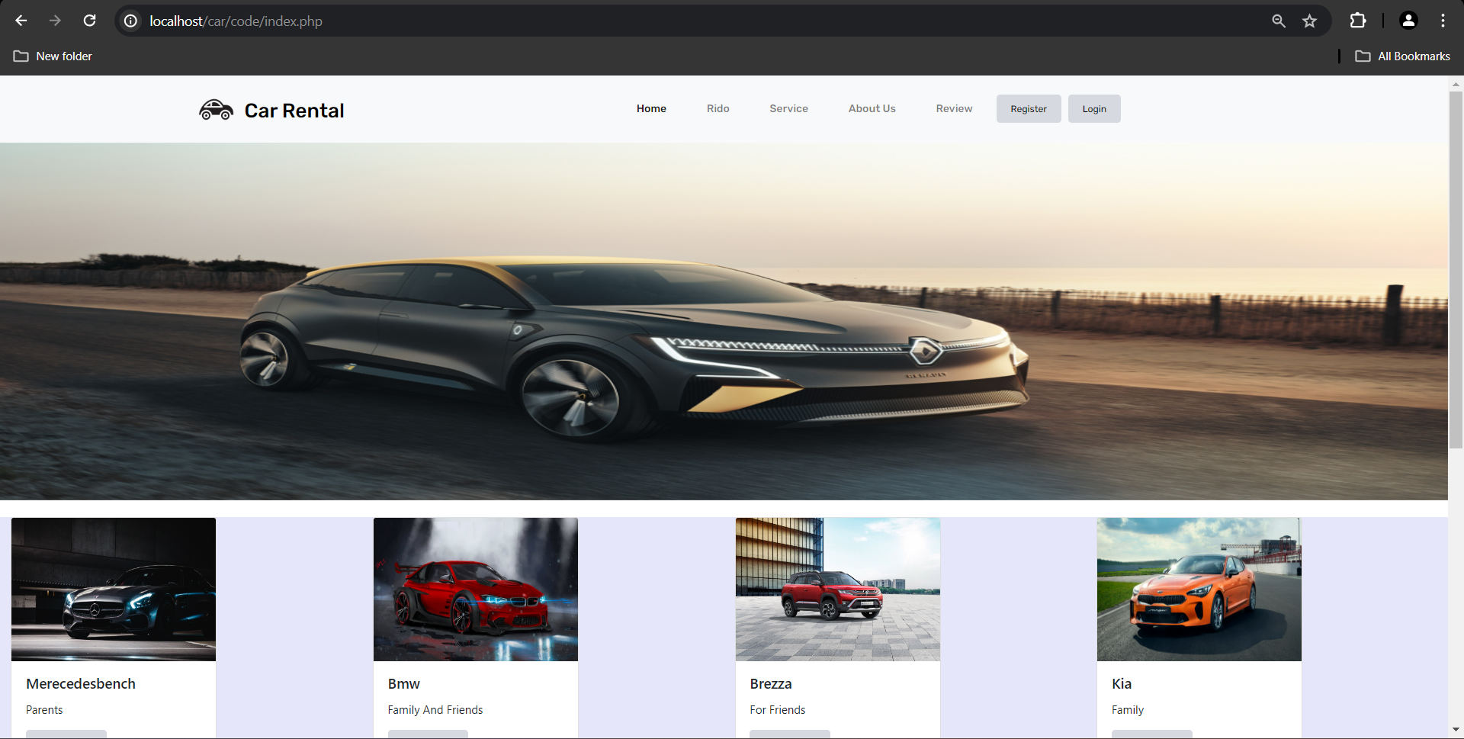
Your Solution and Its Value Proposition

Slide 6
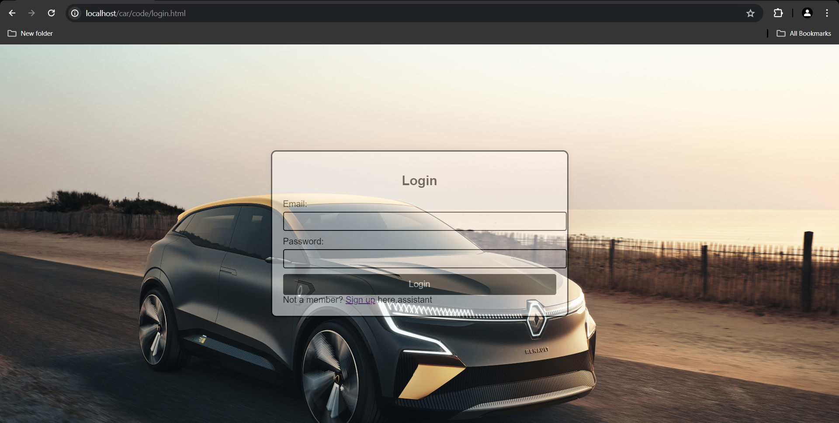
The Wow in Your Solution
Sleek and intuitive design
Personalized user experience
Advanced search and filtering
Eco- friendly options
Mobile app integration
Real-time support

Slide 7
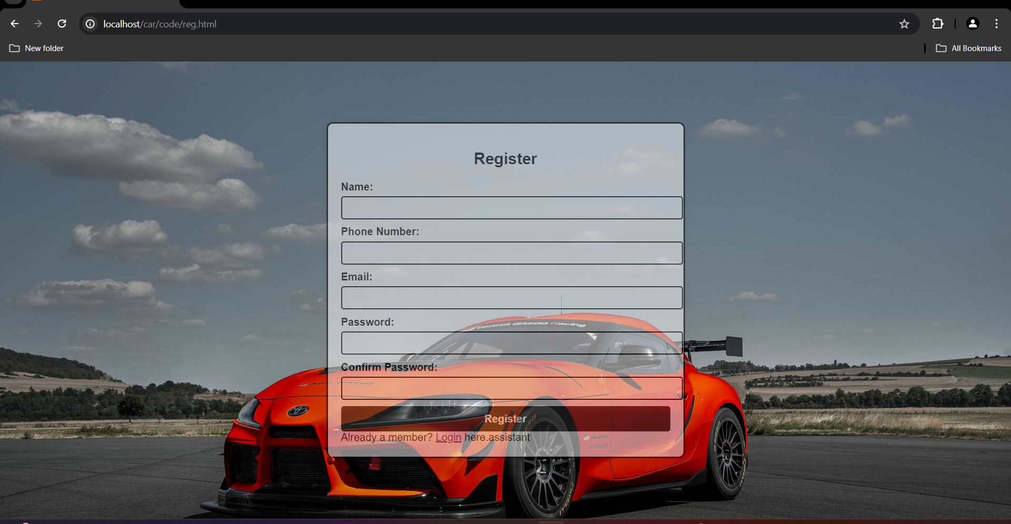
Who are the End Users?
Individual Customers
Corporate Clients
Car rental operator and administrators
Support and development teams
Marketing sales teams
Third-party service providers

Slide 8

Real world use cases
Travel planning
Business
Daily commuting
Special events
Emergency situation

Slide 9

Learning Outcome
Vestibulum eget dui vel mi volutpat tristique.
Aenean sit amet est ultricies, sodales mauris quis, interdum mi.
Quisque consequat nisl ut lorem molestie suscipit.
Nunc vitae turpis accumsan, scelerisque metus id, consequat mi.
Vestibulum sit amet mi non erat faucibus faucibus.

Slide 10
THANK YOU

